Slide 1
Elevate: Concept Video
CJ Indart, Ginelle Servat, Grace Miller, Riley Pittman

Slide 2

About Elevate
“Students connecting for shared success”
Problem/solution overview
Our research revealed that students with a stronger support system experience less stress in the job search process; our mission is to ease this process by linking students with other students who share similar career interests, fostering collaborative networks and mutual growth.

Slide 3
About Elevate
The Name Itself
The app helps students "elevate" their support networks by connecting with peers
The paper airplane in our concept video symbolizes the platform's role in helping students “soar” toward achieving their goals

Slide 4


Market Research
LinkedIn:
What has worked: works very well for getting in contact with recruiters, companies, and jobs; ease of sharing achievements publically; emphasis on professional advancement; not limited to students
What has not worked: not very suitable for forming groups; onus for networking is entirely on the individual user
How ours is unique: solution is exactly what hasn’t worked for LinkedIn -- our goal is to build support groups between students of similar career interests
Handshake:
What has worked: personalized job posting lists for users; university partnership allows for accurate local event suggestions and campus-specific resources
What has not worked: limited social network features or ability to connect users; profiles are often attached to a company or campus partner; networking isn’t encouraged with other colleges
How ours is unique: connects students to students, not students to jobs

Slide 5


Market Research, continued
Meetup:
Description: users can voluntarily join a diverse range of interest-based groups and plan in-person events, focusing on bringing together user within a local radius to facilitate face-to-face connection
What has worked: emphasis on communication with one another at in-person events; multiple group membership allowed; wide range of interests and activities; safety control features
What has not worked: no participation accountability; focus on logistics and “figuring out when/where”
How ours is unique: we’re maintaining a focus on our domain of career-interested students
Bumble Bizz:
Description: one of the three modes within Bumble that aims at matching users within a professional context
What has worked: matching algorithm ensures personalization and mutual acceptance between matches; UI encourages profile depth
What has not worked: 1-on-1 connections can be isolating, matches don’t know each others’ matches; inaccessible—association with Bumble Date means users likely set up a Bumble account for dating before accessing Bumble Bizz
How ours is unique: we’re moving away from the 1-on-1 networking, towards intra-group collaboration

Slide 6

Market Research, continued
Facebook Groups:
Description: online communities within the Facebook platform where users with shared interests engage in discussions
What has worked: helps build community among users over a wide range of interest groups
What has not worked: some users mention large, cluttered groups and others mention inactive group members being an issue
How ours is unique: our platform focuses specifically on students joining groups based on career interests. Groups will also be limited in size and users must participate in groups in order to remain involved

Slide 7
Stakeholders
Direct:
Students seeking jobs and a support group
University career services and advisors
Indirect:
Employers & job recruiters who receive applications
Relatives or dependents of student users

Slide 8
Ethical Implications
The Smash Hit:
competition for jobs could increase and job applicants may feel more pressure to keep up with others if so many are constantly networking
  Solution: focus platform on support and community, not resources or connections
with lots of community members, students could subconsciously self-select team members with familiar backgrounds & demographics
  Solution: use matching algorithms that promote diversity, or make group assignments completely automated with no user participation/selection
The Big Bad Wolf:
a bad actor using this platform could use it to give other students bad advice or purposefully try to sabotage their chances of getting a job
  Solution: we can implement a feedback and reporting system that allows users to report if a user is misusing the platform
like all social media platforms, susceptible to catfishing and stalking
  Solution: in addition to the above feedback system, we can include a verification system that requires academic (.edu) email addresses or other means to verify identity

Slide 9
Tasks
Simple: connect with a person
  This is the most basic function of the app
  Time approximation: 0:22
Moderate: consistent communication
  The app needs to connect individuals with aligned interests to encourage ongoing communication, which is both challenging and takes time to achieve
  Time approximation: 0:55
Complex: gain confidence, learn from peers, and motivate one another to achieve career goals
  Support groups are meant to help students learn from each other and help each other achieve their goals, but to do so it requires a positive group dynamic and participation among group members -- difficult to achieve
  Time approximation: 1:09

Slide 10
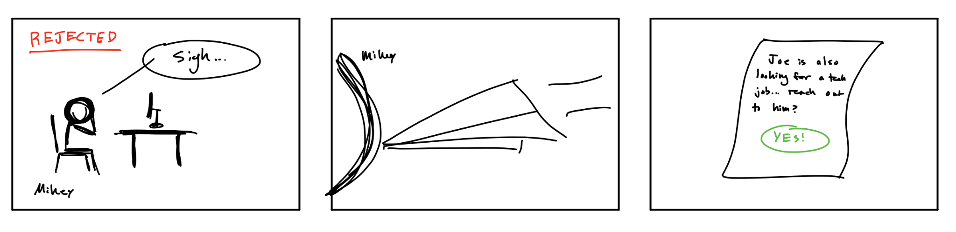
Storyboarding
Protagonist Mikey gets rejection letter from dream job
Mikey sees paper airplane fly in and hit him
The letter says that Joe is also looking for a job, and if Mikey would want to connect

Slide 11
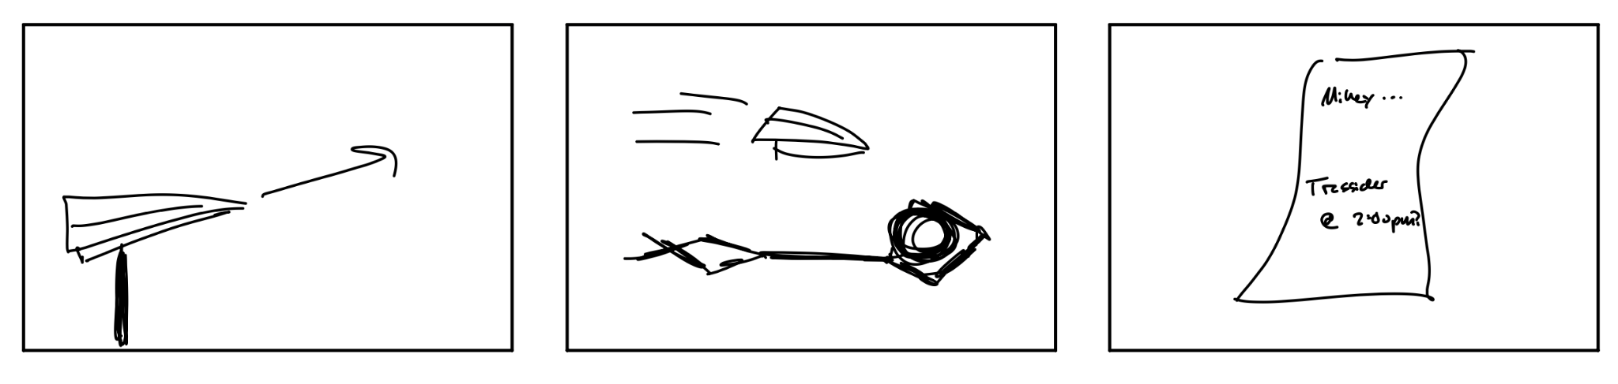
Storyboarding
Another paper airplane flying
Joe gets hit with a paper airplane now
Asks Joe to connect with Mikey at Tresidder

Slide 12
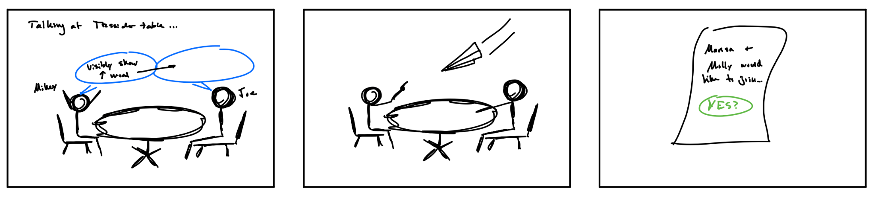
Storyboarding
Mikey and Joe are engaging in conversation, talking about careers
A paper airplane hits them now
It says that Marissa and Molly would also like to join the group

Slide 13
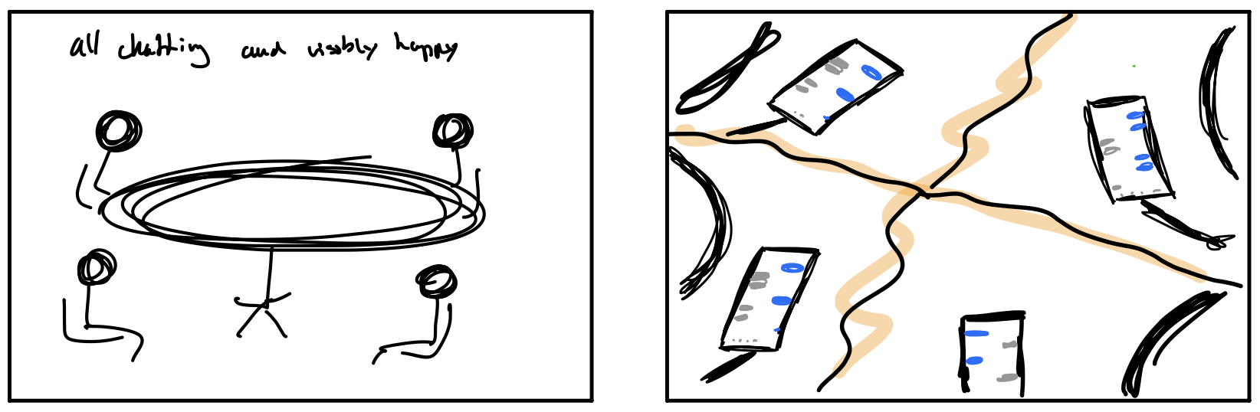
Storyboarding
Marissa and Molly appear at the table and they all seem happier
They all exchange phone numbers and say goodbye

Slide 14
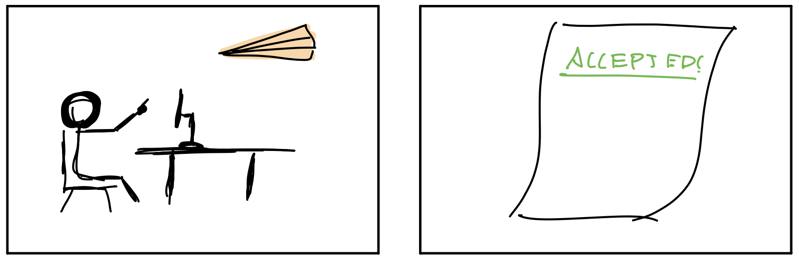
Storyboarding
Shows each member of the group getting hit with a paper airplane at their desk
The paper airplane is a note saying something good in their job search (offer, new interview, etc.)

Slide 15
Our Video
https://youtu.be/PXgOhZS1XbA

